Slide 1
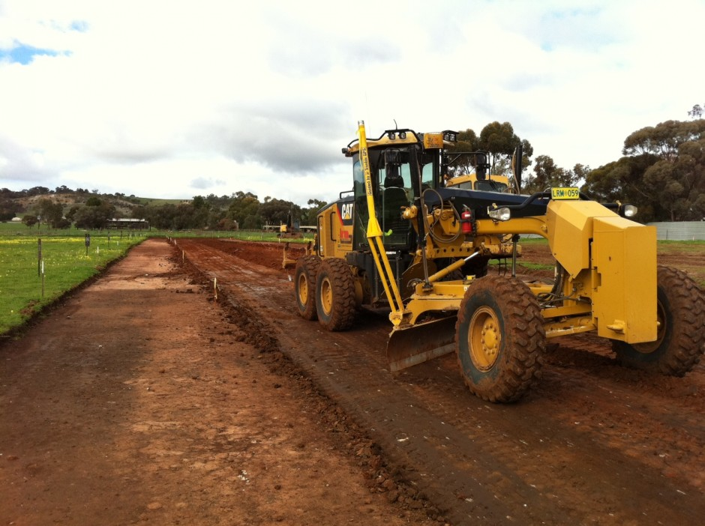
Public Procurement
Institutions Capacity Development

Slide 2
DEFINITION
“The process through which individuals, organizations and societies obtain, strengthen and maintain the capabilities to set and achieve their own development objectives over time. Capacity Development helps strengthen institutions to perform better and more consistently over time and to respond to and manage shocks and changes.”

Slide 3
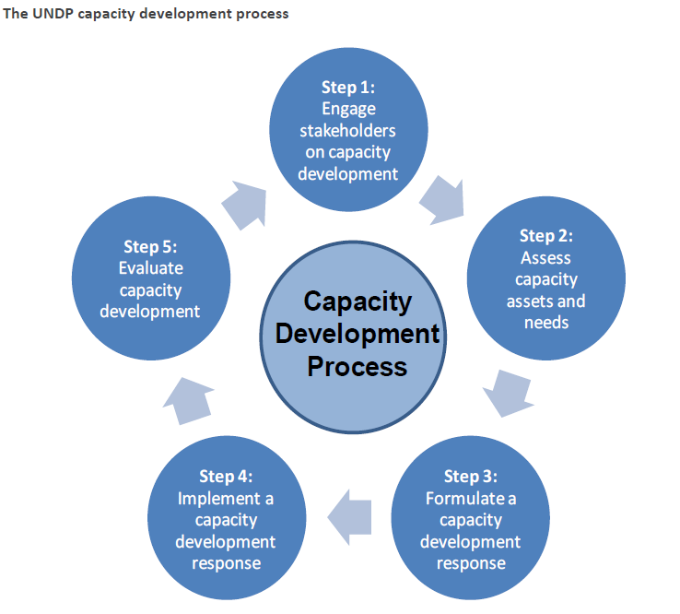
CAPACITY DEVELOPMENT PROCESS
DESIRED CAPACITIES EXISTING CAPACITIES

Slide 4
ASSESING PROCUREMENT CAPACITY
National Procurement System
OECD/ DAC MAPS
Institutional
Organization
Day-to-day capacity

Slide 5
INSTITUTIONAL PROCUREMENT CAPACITY ASSESMENT
Structured & standardized
Easy-to-apply and flexible to customize to institutions of different size and resources
Adopt a simple methodology
Holistic; structure, organization, protocols, systems and day-to-day operations
Management tool to foster dialogue and to identify opportunities
Number based model to reduce subjectivity

Slide 6
RISK MANAGEMENT APPROACH
Step 1
Risk classification
Step 2
Action plan
Monitoring
Step 3
Supervision plan
Mitigating measures
Allocate resources
HIGHER THE RISK CLOSER THE SUPERVISION

Slide 7
CAPACITY DEVELOPMENT RESPONSE
Focus on the root cause/ underlying reasons for the gap
Generate ideas for initiatives
Realistic funding and timelines
Cross-cutting issues

Slide 8
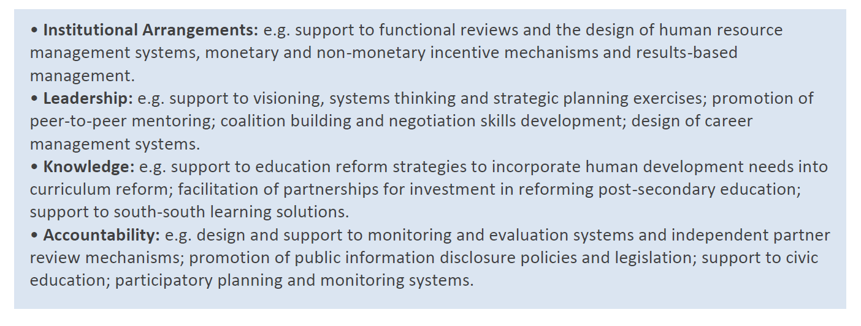
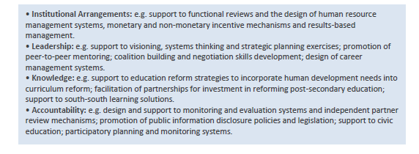
CAPACITY DEVELOPMENT RESPONSE

Slide 9
CHALLENGES
Assessment fatigue
Suspicions about the use of assessment results
Disconnection between assessment findings and capacity development response

Slide 10
LESSONS LEARNED
Adopt capacity assessment as a management tool
Adapt to the local context and needs
Built in time to mobilize the stakeholders and design the assessment
Ensure sufficient time to ensure collection of data and information
Ensure local ownership
Be systematic

Slide 11
USEFUL LINKS & DOCS
UNDP Resources
Procurement Capacity Development Centre: http://www.unpcdc.org
UNDP Capacity Development: http://www.undp.org/capacity
UNDP Capacity Assessment Methodology: http://content.undp.org/go/cms-service/download/publication/?version=live&id=1670209
UNDP Capacity Assessment Practice Note: http://content.undp.org/go/cms-service/download/publication/?version=live&id=1448681
UNDP Capacity Development Practice Note: http://content.undp.org/go/cms-service/download/publication/?version=live&id=1449053
UNDP Paper on Measuring Capacity: http://content.undp.org/go/cms-service/download/publication/?version=live&id=2679640
Other UN Resources
UNDG Capacity Development: http://www.undg.org/index.cfm?P=225
OECD-DAC Task Force for Procurement
Website: http://www.oecd.org/document/59/0,3343,en_2649_3236398_43440827_1_1_1_1,00.html
Methodology for Assessment of National Procurement Systems (MAPS): http://www.unpcdc.org/key-resources/searchlib.aspx?docid=9942

Slide 12
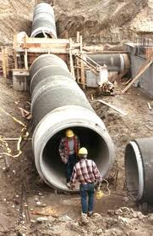
THANKS!

